Slide 1
SERVLETS
CIT 360 GROUP 4 EDGAR ROMERO

Slide 2
CODING TOPIC INTRODUCTION
SERVLETS
A Java servlet is a Java software component that extends the capabilities of a server. Although servlets can respond to many types of requests, they most commonly implement web containers for hosting web applications on web servers and thus qualify as a server-side servlet web API. Such web servlets are the Java counterpart to other dynamic web content technologies such as PHP and ASP.NET.
References
Doing more with Java, page 103 and 67
Servlets:
https://www.geeksforgeeks.org/introduction-java-servlets/
https://www.youtube.com/watch?v=CRvcm7GKrF0
https://en.wikipedia.org/wiki/Java_servlet

Slide 3
SERVLET
You’ve seen all of the pieces now let’s take a look at how to create a servlet that uses the Application Controller pattern and Hibernate. The sample consists of a small portion of a JSON service for an online store. To keep it simple, only some of the store will be created in code. You’ll see handlers for registering, logging in, and logging out, but not for other things like searching for a product, adding a product to a cart, checking out, and paying.

Slide 4
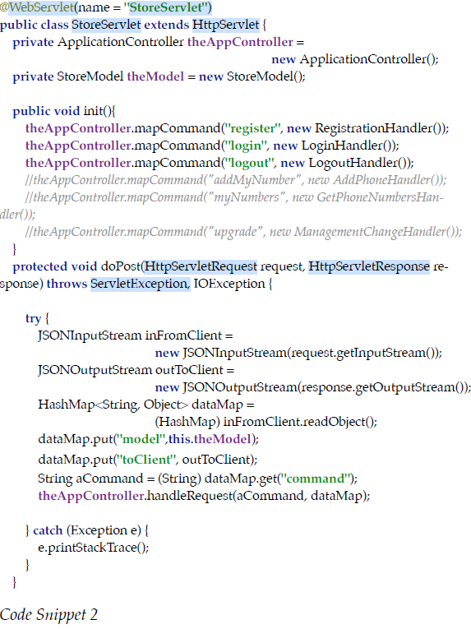
SERVLET

Slide 5
SERVLET
Servlets are little pieces of code you write that run inside the Tomcat server. Each time a request is made, Tomcat is responsible for finding the appropriate servlet to execute based on the URL it is sent. It also parses all the rest of the HTTP information it gets from the browser into ArrayLists, HashMaps, and builds any other appropriate objects to make it easier for your code to focus on handling what ever request was made. Just like a server at a good restaurant takes care of all kinds of things for you so you can focus on enjoying your meal, Tomcat does all of this for you.

Slide 6
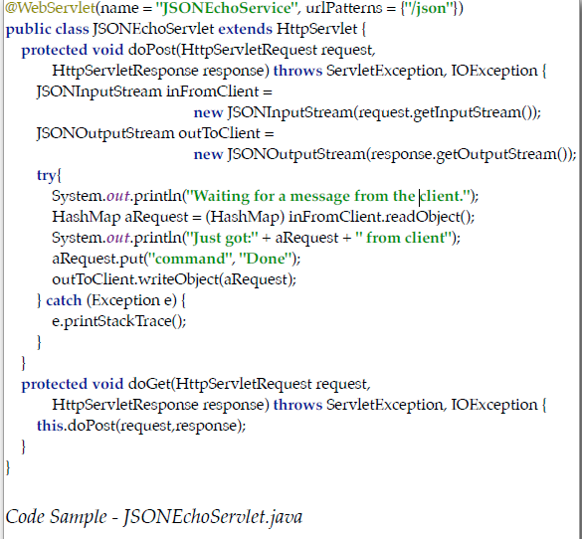
SERVLET
What’s that @WebServlet stuff?” you noticed that did you? That is called an annotation. Annotations were added to Java quite some time ago. They let you decorate an instance of a class with extra information. Way back in the old days, in order to get Tomcat to know which servlet to run for a specific URL, you would have had to edit an XML file. That’s not too much fun and it can make it hard to fix bugs. You would have had to make changes in two files instead of one. Because of that, the engineers in charge of Java EE created annotations for you to use instead of the XML file.
@WebServlet is one of the annotations they created. Since all annotations always apply to the next line of regular Java code, the annotation line of code reads, “Associate the name ‘JSONEchoService’ and the urlPattern ‘/json’ with the JSONEchoServlet.” By including this annotation, any time a client uses a URL that looks something like ‘http://localhost/json,’ Tomcat will do its thing, create the request and response instances, and send them to the JSONEchoServlet’s doGet or doPost method and off you go.

